Slide 1

20 Years of Software Development
What could possibly go wrong?

Slide 2


Kate
These two just left college
Christian

Slide 3
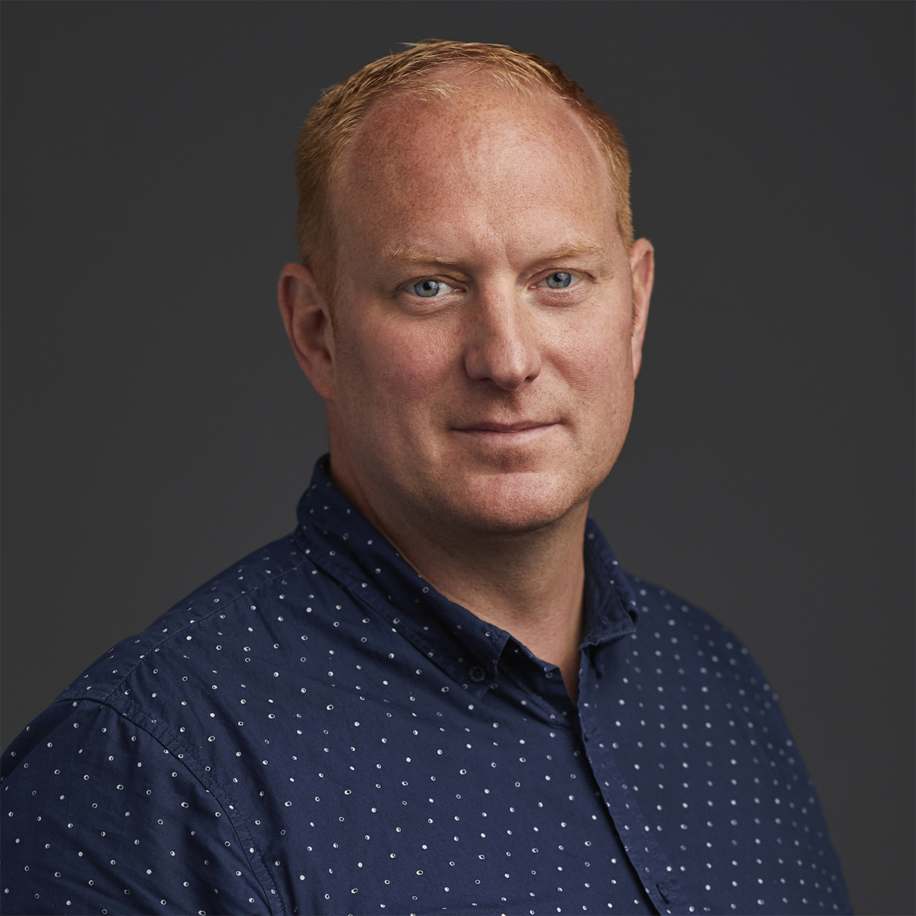
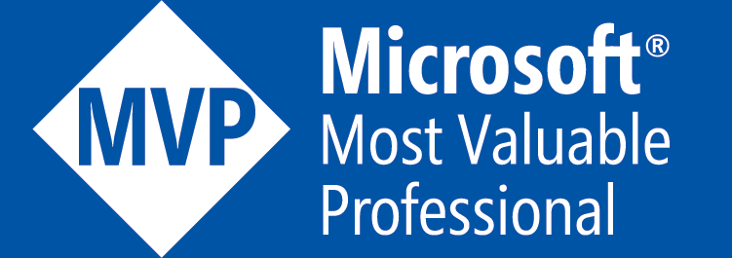
Eduard Keilholz
Eduard Keilholz is a seasoned software developer and cloud architect at 4Dotnet, where he specializes in Microsoft development and cloud technologies.
https://www.linkedin.com/in/eduard-keilholz/
https://github.com/nikneem
https://hexmaster.nl/

Slide 4

The SOLID Police

Slide 5
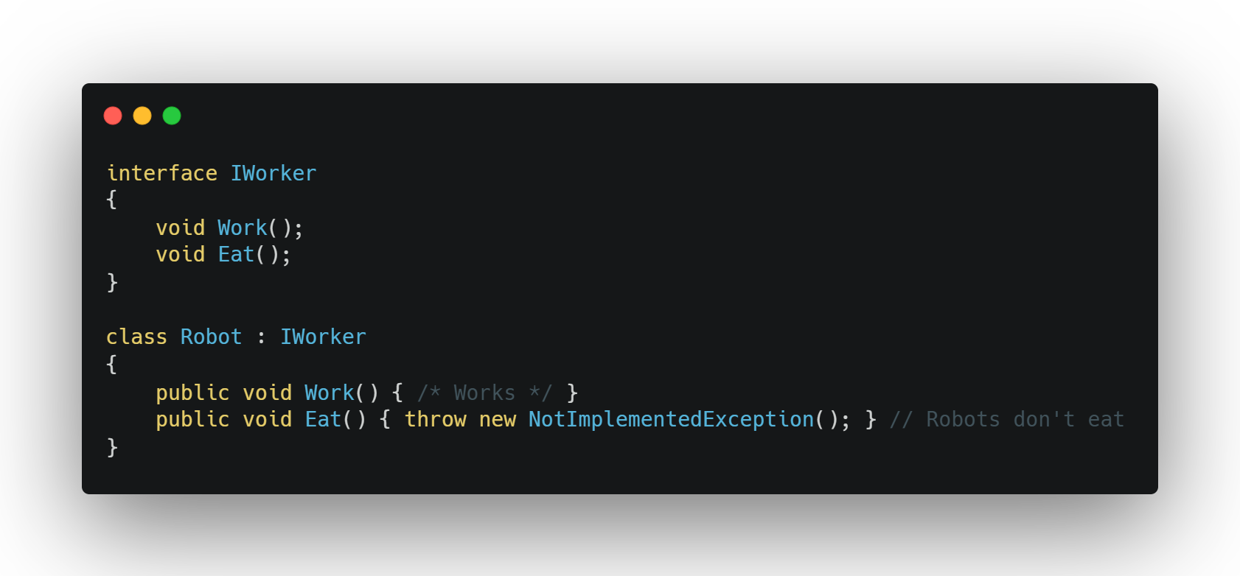
SOLID Gone wrong
Don't Overdo SRP - Think Cohesion
Deep Inheritance Tree Gone Wrong
Violating expected behavior
Too many small interfaces
Notes:
Single Responsibility - People often interpret "responsibility" as "a class should only do one thing," leading to an extreme where classes become too granular and fragmented.
Open Close - People think this means always using inheritance for extensibility, leading to deep inheritance chains that make the code harder to maintain.
Liskov Substitution - People focus only on syntax compatibility but ignore behavioral compatibility, leading to unexpected failures.
Interface Segregation Principle - Some developers over-segment interfaces, leading to too many tiny interfaces that increase complexity rather than solve problems.

Slide 6
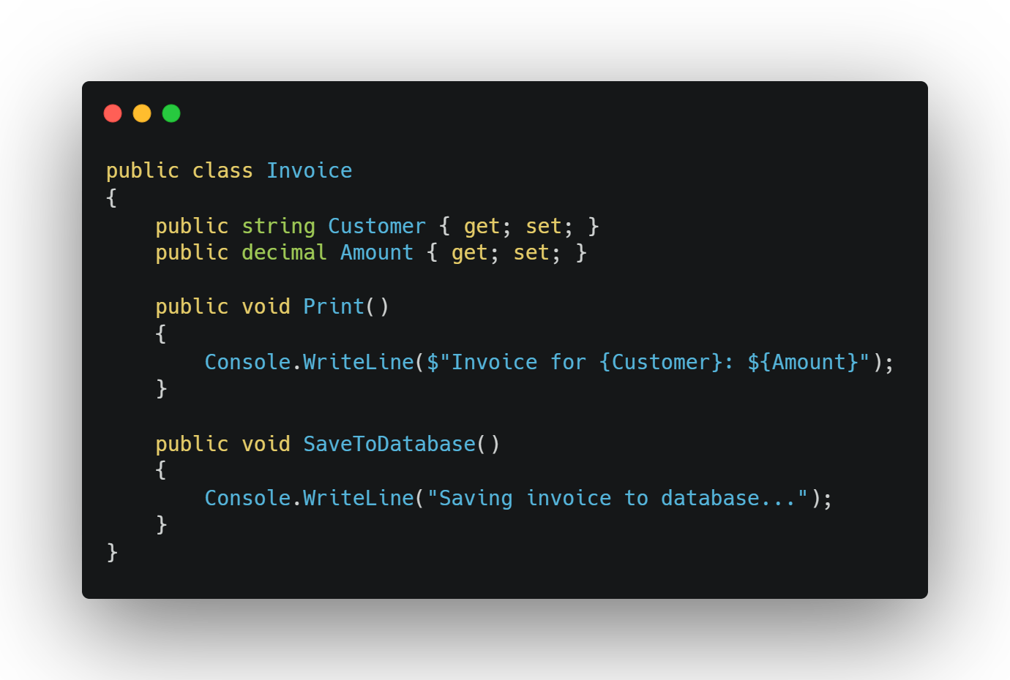
Single Responsibility Gone wrong
What, two responsibilities, are you mad?
Notes:
Single Responsibility - People often interpret "responsibility" as "a class should only do one thing," leading to an extreme where classes become too granular and fragmented.
Open Close - People think this means always using inheritance for extensibility, leading to deep inheritance chains that make the code harder to maintain.
Liskov Substitution - People focus only on syntax compatibility but ignore behavioral compatibility, leading to unexpected failures.
Interface Segregation Principle - Some developers over-segment interfaces, leading to too many tiny interfaces that increase complexity rather than solve problems.

Slide 7
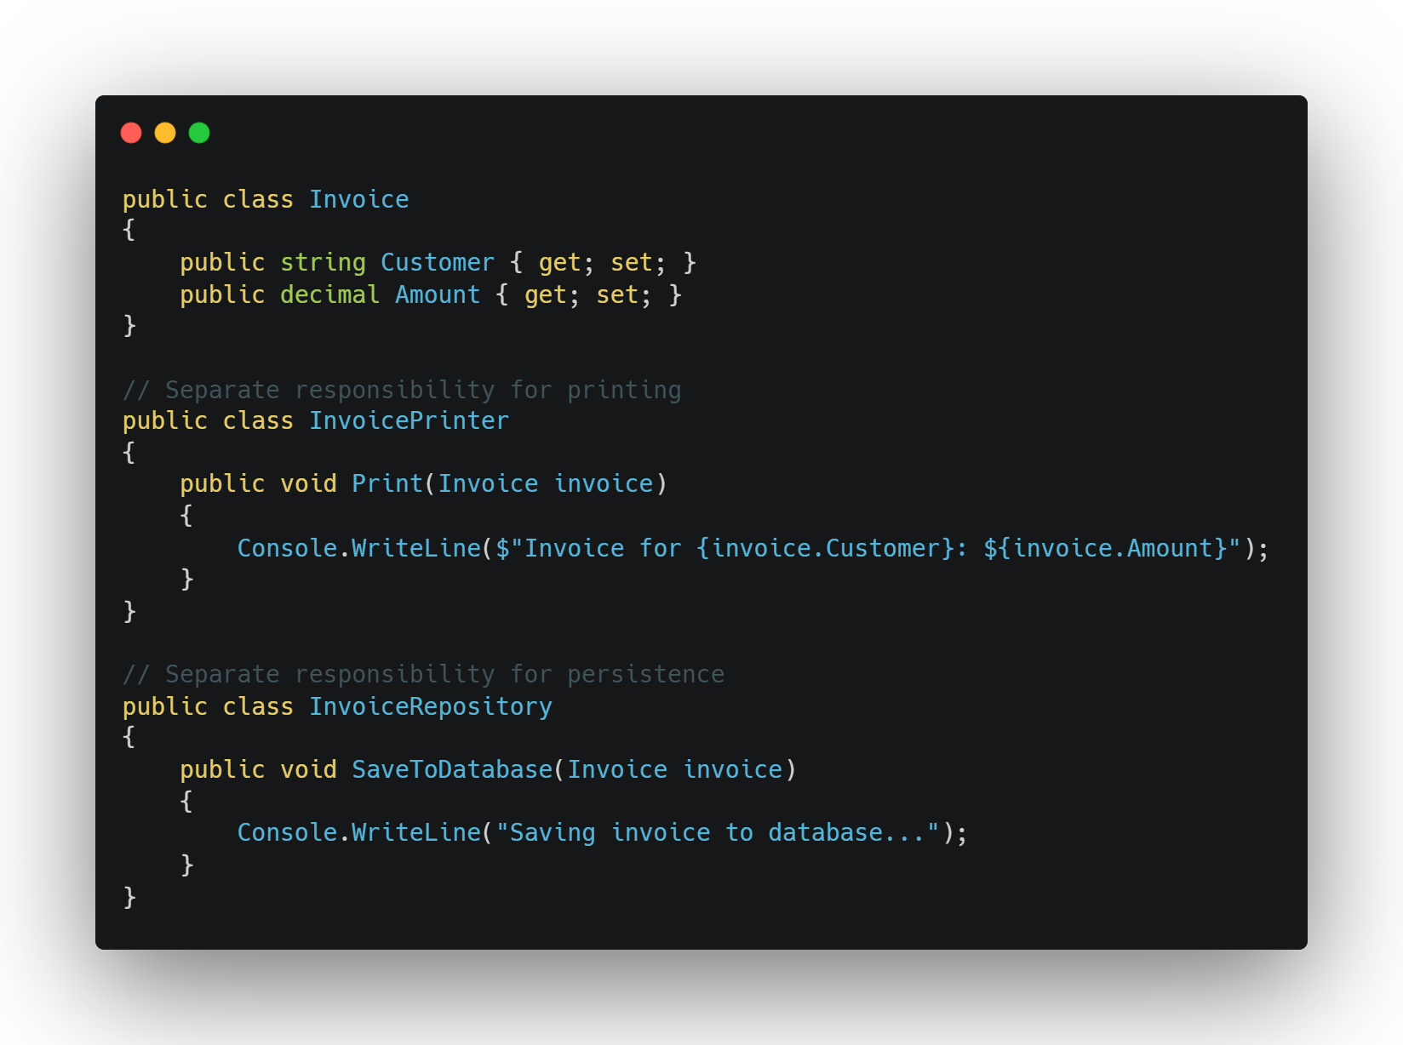
Notes:
Single Responsibility - People often interpret "responsibility" as "a class should only do one thing," leading to an extreme where classes become too granular and fragmented.
Open Close - People think this means always using inheritance for extensibility, leading to deep inheritance chains that make the code harder to maintain.
Liskov Substitution - People focus only on syntax compatibility but ignore behavioral compatibility, leading to unexpected failures.
Interface Segregation Principle - Some developers over-segment interfaces, leading to too many tiny interfaces that increase complexity rather than solve problems.

Slide 8
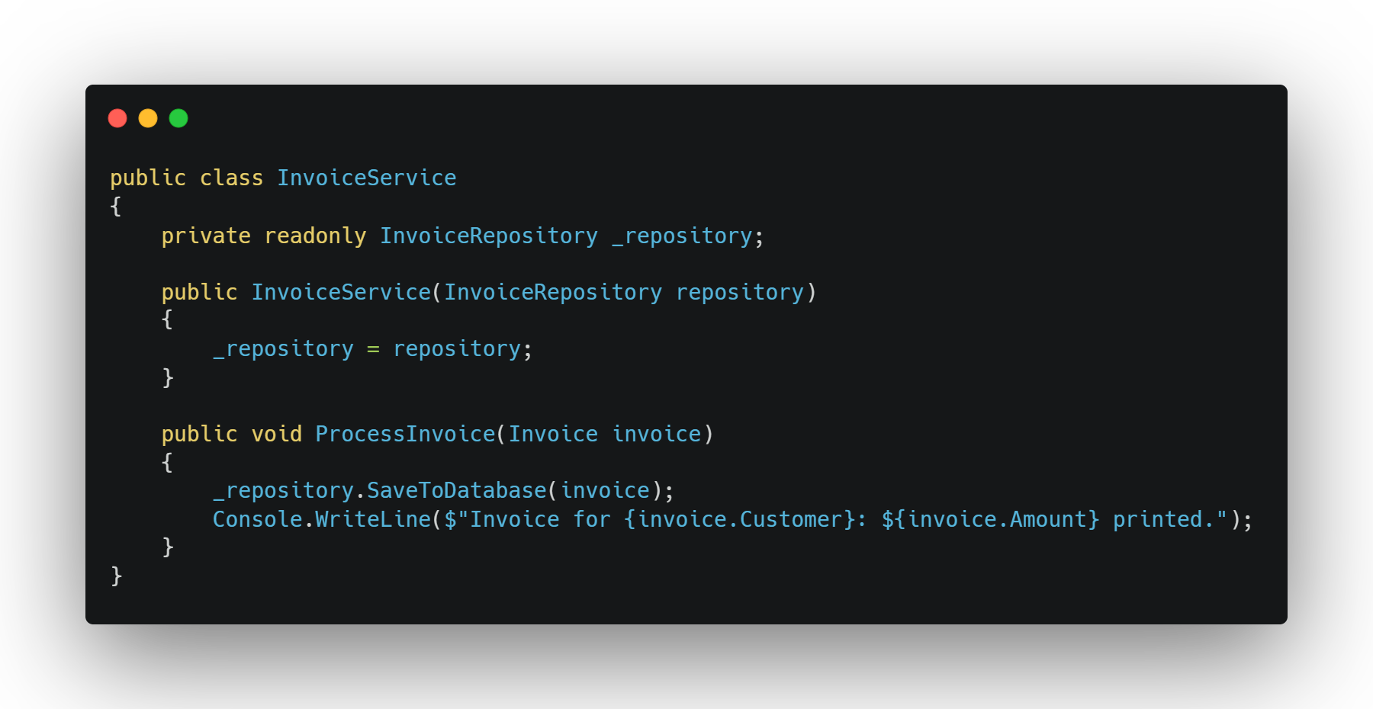
Notes:
Single Responsibility - People often interpret "responsibility" as "a class should only do one thing," leading to an extreme where classes become too granular and fragmented.
Open Close - People think this means always using inheritance for extensibility, leading to deep inheritance chains that make the code harder to maintain.
Liskov Substitution - People focus only on syntax compatibility but ignore behavioral compatibility, leading to unexpected failures.
Interface Segregation Principle - Some developers over-segment interfaces, leading to too many tiny interfaces that increase complexity rather than solve problems.

Slide 9
Notes:
Single Responsibility - People often interpret "responsibility" as "a class should only do one thing," leading to an extreme where classes become too granular and fragmented.
Open Close - People think this means always using inheritance for extensibility, leading to deep inheritance chains that make the code harder to maintain.
Liskov Substitution - People focus only on syntax compatibility but ignore behavioral compatibility, leading to unexpected failures.
Interface Segregation Principle - Some developers over-segment interfaces, leading to too many tiny interfaces that increase complexity rather than solve problems.

Slide 10
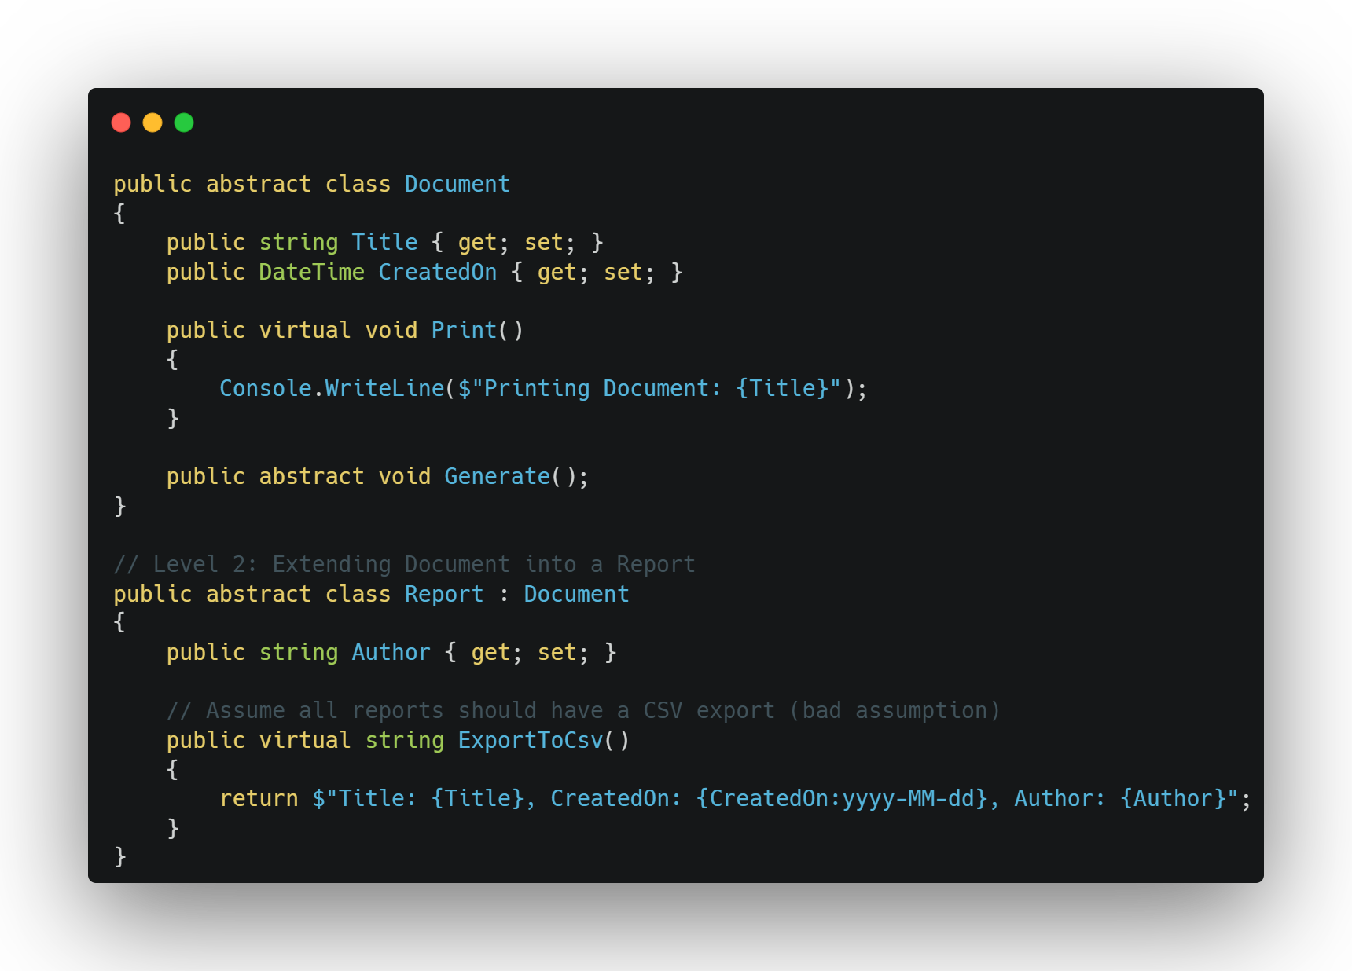
Open/Close principle gone wrong
O-Ohh, someone made an assumption!?
Notes:
Single Responsibility - People often interpret "responsibility" as "a class should only do one thing," leading to an extreme where classes become too granular and fragmented.
Open Close - People think this means always using inheritance for extensibility, leading to deep inheritance chains that make the code harder to maintain.
Liskov Substitution - People focus only on syntax compatibility but ignore behavioral compatibility, leading to unexpected failures.
Interface Segregation Principle - Some developers over-segment interfaces, leading to too many tiny interfaces that increase complexity rather than solve problems.

Slide 11
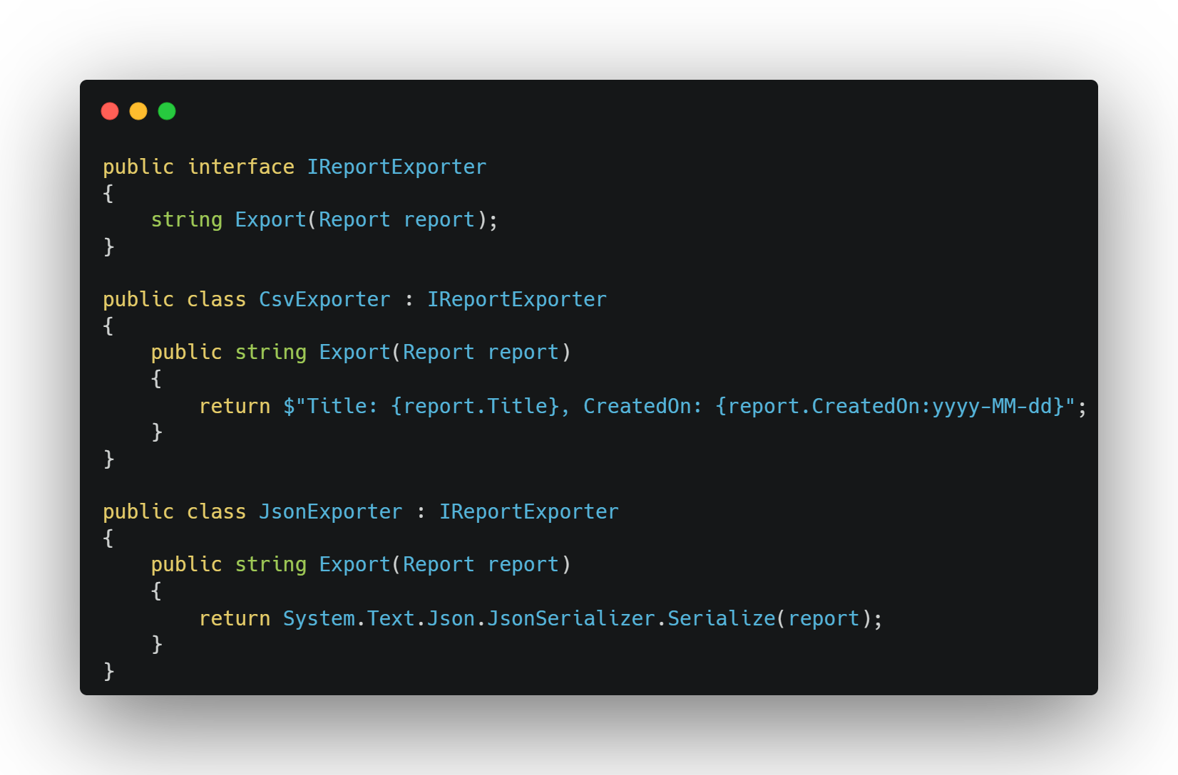

Slide 12
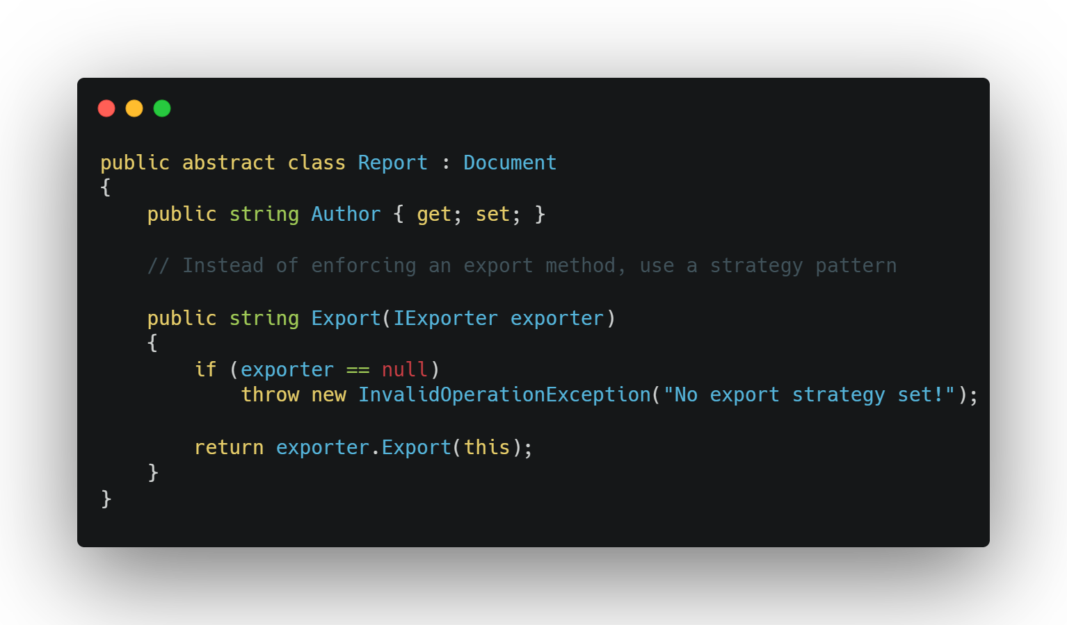

Slide 13
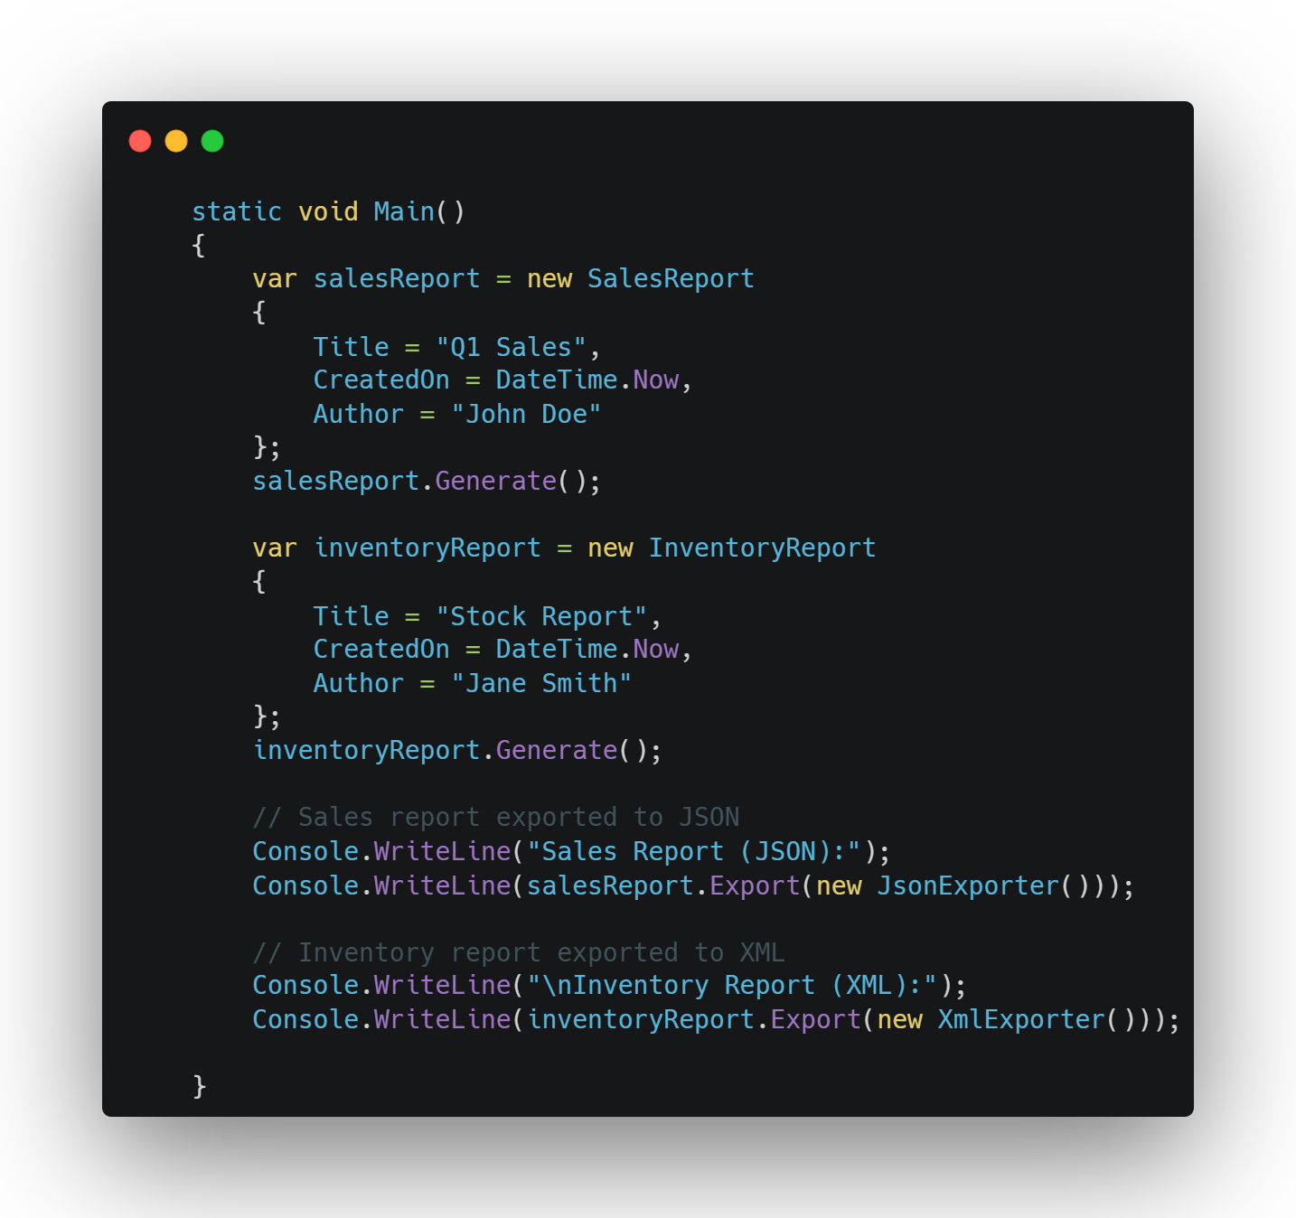

Slide 14

It depends
On a package

Slide 15

Monolith
?
Microservices

